Slide 1
Washington D.C. Traffic Accident Dashboard
Sam Clark and Joanne Choi
8/18/2022

Slide 2
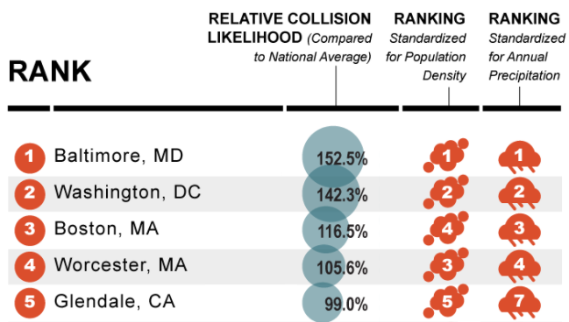
Overview
Problem
Washington DC has the 2nd highest vehicle collision rate in the U.S.
Compared to the average commute time of 27 minutes, DC commuters spend an average of 43 minutes
Solution
We developed an interactive dashboard that contains machine learning components that can help inform D.C. commuters on the risk of commuting on a given day
Based on 2019 Allstate America’s Best Driver Report¹
Notes:
National Capital Region Transportation Planning Board. (2019, September 17). 2019 STATE OF THE COMMUTE SURVEY Technical Survey Report. https://www.mwcog.org/file.aspx?&A=1AAuS26tuk0qvTVF52Q7%2BD87l582VWw4yNkHhrI8JrM%3D.
Berkon, E. (2020, January 24). D.C. has some of the longest commutes in the COUNTRY. what help is available? Retrieved April 03, 2021, from https://www.npr.org/local/305/2020/01/24/799292338/d-c-has-some-of-the-longest-commutes-in-the-country-what-help-is-available.
The 50 Cities Where You're Most Likely to Get in an Automobile Accident. (n.d.). https://www.automotivetouchup.com/touch-up-paint/cities-most-likely-to-get-in-automobile-accident.

Slide 3
Machine Learning Models
Regression model predicting the number of car accidents likely to occur
~82% accuracy
Classification model predicting the level of severity for a given accident
~97% accuracy
~95% recall for each class
~97% precision for each class
XGBoost performed the best for both regression and classification models

Slide 4
Dashboard Demo

Slide 5
Future Work and Improvements
Regression Model:
Investigate model stacking to improve performance
Add more data including traffic volume
Classification Model:
Concerns for overfitting
“No Injuries” class missing from data
Oversampling method (SMOTE)
Include additional accident data from MD and VA
Continuously integrating accident data to keep the models up to date

Slide 6
Takeaways
Most number of car accidents occur in:
May
Wednesday
5AM
Car accidents are highly correlated with precipitation

Slide 7
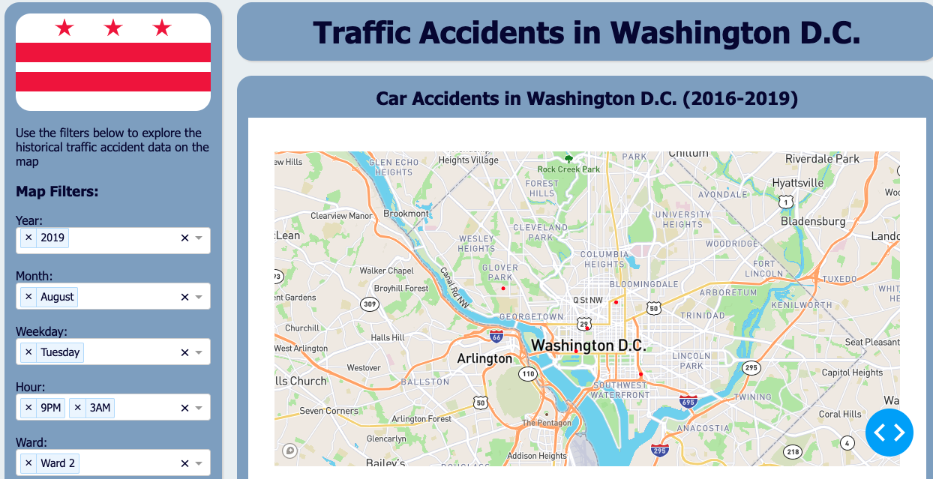
Questions?

